Slide 1


Path Computation Element ( PCE) & its relationship to
Software Defined Network ( SDN)
Dhruv Dhody
PCE WG Co-Chair

Slide 2

Dhruv Dhody
Principal Engineer Huawei-India
At IETF - PCE WG Co-Chair, Routing Directorate member,
Sargent-at-arms for IETF mailing list
Secretary for IIESoc & INTC
‹#›

Slide 3
Outline
Basic Concepts
Stateful PCE
Software Defined Networking (SDN) PCE & SDN
What’s next?
‹#›

Slide 4
Traffic Engineering (TE)
Beyond just Reachability
SPF to CSPF (constrained SPF)
Get a more reliable traffic delivery
Better use of network resource
Ability to re-route around outages and planned maintenance
Better network and service planning (make n/w predictable)
Offer advanced services
Why TE?
Topology: nodes and links and connectivity
Capabilities: bandwidth, delay, packet loss, metrics
Traffic: patterns, demands, matrix
Errors and planning
You need to know your
network!
Then you need a way to control how the traffic flows through the
network
Configure your nodes
Identify the traffic
Management tools
‹#›

Slide 5
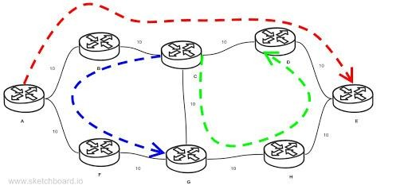
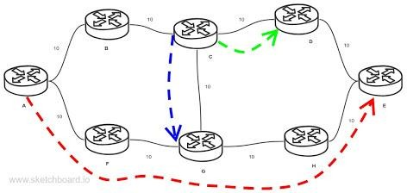
But, we still have a problem
A Global view for network
optimization is needed
  We need to know
    The network topology
    The status of all links
      Available bandwidth
      Other constraints
    All demands (paths)
    Any relationships between demands
All links are 10GB A->E is 6 GB
C->D is 8 GB
C->G is 4 GB
Someone who can place a set of demands and tweak the network as required!
‹#›

Slide 6

And that’s where PCE comes in
A Path Computation Element (PCE) is an entity (component, application, or network node) that is capable of computing a network path or route based on a network graph and applying computational constraints.
RFC 4655
‹#›

Slide 7
More of ‘Why PCE?’
The path computed by the source node with limited visibility
Limited topology, perhaps only per-domain
  Applicability to multi-domain and multi-layer (IP/Optical)
Global view is needed to know all demands (paths)
Source node may not have enough computation power or memory
Low end devices as network edge
Improve network optimization
Customizable Path Computation algorithms
Think of 5G like requirements!
‹#›

Slide 8
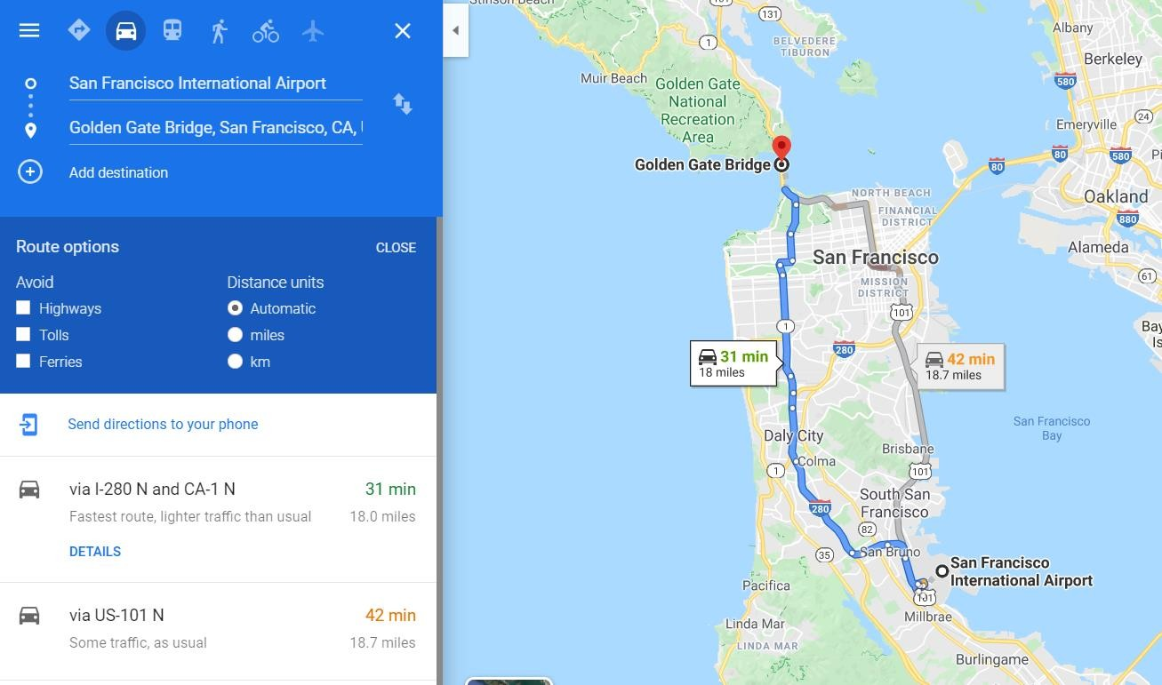




Maps
Endpoints
Constraints
Path
Traffic Engineering Database with real- time characteristics
INNOG 3, 7 AUG 2020
8

Slide 9
The basics first!
Path Computation Element
Could be a part of network controller
Specializes in complex path computation on behalf of PCC
PCE
Path Computation Client
Router offloads path computation to a specialized PCE
Could be NMS!
PCC
PCEP
PCE Protocol to communicate between PCC and PCE(s) using TCP
Chartered in 2004
  Yes, its old!
First RFC – RFC4655 (in 2006)
Since then 54 RFCs further published!
PCE WG

Slide 10




PCE Architecture
LSR
Server
PCE
Server
PCE
NMS
TED
TED
TED
TED
PCE
PCE
LSR
LSR
LSR
LSR
LSR
LSR
LSR
Signalling
Signalling
Engine
Signalling
Engine
Signalling
Engine
Signalling
Engine
Signalling
Engine
Signalling
Engine
Signalling
Engine
Engine
When head-end routers did path computation – it included a PCE component
When the NMS determined paths and instructed the network – It included a PCE component
The PCE architecture recognizes these and allows PCE to be externally visible perhaps on a
dedicated server!

Slide 11
The Protocol
Open
PCEP: PCE Protocol to communicate between PCC and PCE(s)
PCC requests a computation
From where to where?
What type of path? (Constraints)
  Bandwidth requirement
  Cost limits, etc.
  Diversity requirements
PCE responds with a path (or failure)
Details of route of path
Details of parameters of path
  Actual cost, bandwidth, etc.
Keepalive
Request
PCEP Messages
Response
Notification
Error
Close

Slide 12

The Initial Journey at PCE WG!
Basic PCEP
RFC 5440
BRPC – PCE Inter-
domain
RFC 5441
Confidentiality in
PCEP – Path Key
RFC 5520
Exclusion - for
diverse paths
RFC 5521
Objective
Functions
RFC 5541
P2MP/Multicast
RFC 6006 / RFC 8306
Hierarchy of PCE
(H-PCE)
RFC 6805
RFC 8685
GMPLS network
RFC 7025
RFC-to-be 8779
Inter-layer
RFC 8282
Optical
WSON
Impairment aware

Slide 13
But, Stateless!
Even though PCE could do complex path computation by itself (or by working with other PCEs)
It could do that only when the PCC asks for it!
Even when PCE learns of topology change - It
cant do much!
and stateless!
So far the PCEP was a simple client- server protocol
Only consider the network topology (TEDB – Traffic Engineering Database)
And not *all* paths established in the network

Slide 14



Stateful PCE
Now, along with network state (TEDB), if the PCE also stores the state of all the demands (computed paths or LSPs) and their resources (lets call it LSP-DB)
  We could do so much more and that is Stateful PCE!
The Stateful PCE can do global re-optimization considering various LSPs to optimize the whole network!
New Messages
Report – PCC reports the status to PCE
Update – PCE update the path
to PCC
It uses the TEDB and LSP-DB while path computation, but computation is done only when requested by PCC.
Passive
It allows the control of the LSP to be delegated to a PCE where the PCE becomes the owner of the LSP and can change any attribute of the LSP at anytime.
Active

Slide 15






















PCE Initiated
Setup, maintenance and teardown LSPs directly by the
PCE!
  No need for local configuration at the device!
Allowing for a dynamic network that is centrally controlled and deployed.
Useful when the LSP placement needs to change in
response to application demands.
Agile network operations.
A new PCEP message to initiate LSP from PCE to PCC.
PCE Initiate
Message

Slide 16


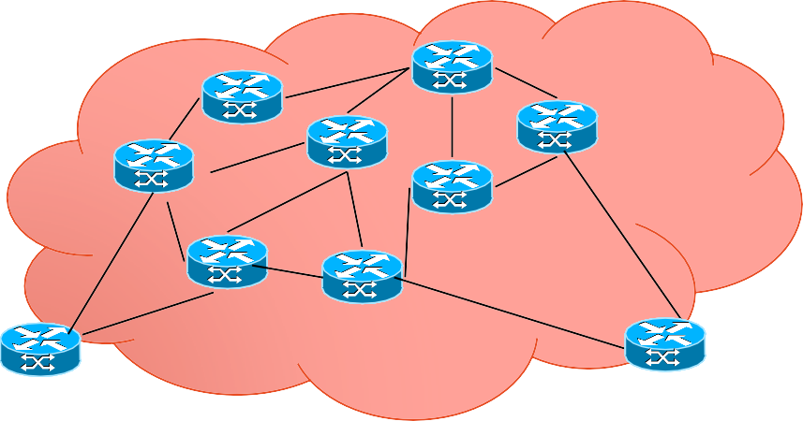
Segment Routing (SR) & PCE
Segment Routing Path where the PCE prepare label stack identifying node and adjacency labels
  PCE computes the SR Path and instructs the head-node with a label stack. PCE can respond to network events like congested links and update the label stack.
Stateful PCE
PCEP extensions
🢝 RFC8664
PCE capability advertisement
New path setup type
  “This is an MPLS-SR path”
New sub-objects for SR paths
  SR-ERO/SR-RRO
with SR
PCEP
Protocol
1417
1568
1923
payload
16

Slide 17
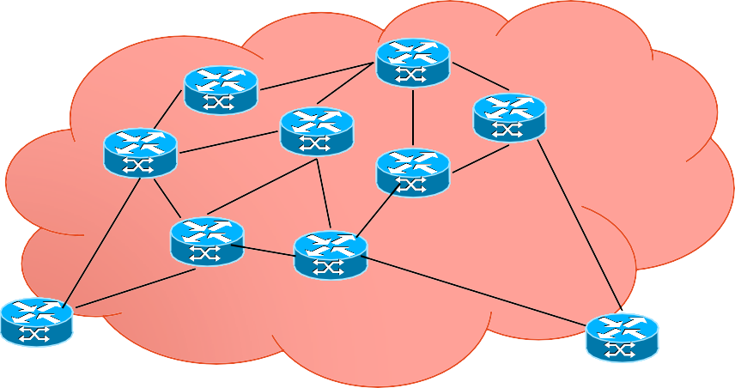


SRv6 & PCE
Stateful PCE
with SRv6
For a PCE SRv6 looks quite a lot like MPLS-SR
  The Segment Routing Path is a SID list
A PCE can compute SRv6 paths considering
  Source and destination
  Flow characteristics
  Current network condition and loads
  Network programming
PCEP extensions to support SRv6
  draft-ietf-pce-segment-routing-ipv6
  PCE capability advertisement
  Path type identifiers
    “This path is used for SRv6”
  Extended ERO and RRO for SR
    Sub-objects for SRv6
PCEP Messages
A::1
B::1
C::1
payload

Slide 18
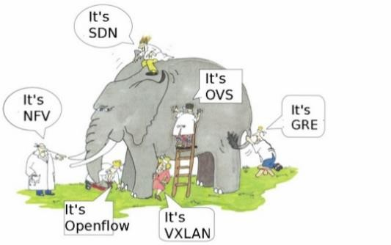
Lets talk about SDN!
Initial Definition - The physical separation of the network control plane from the forwarding plane, and where a control plane controls several devices.
Folks who might think openflow *is*
SDN!
Software-defined networking (SDN) is an approach to computer networking that allows network
administrators to manage network services through abstraction of lower-level functionality.
Directly programmable
Agile
Logically centrally managed
Programmatically configured
Open standards-based and vendor-neutral

Slide 19
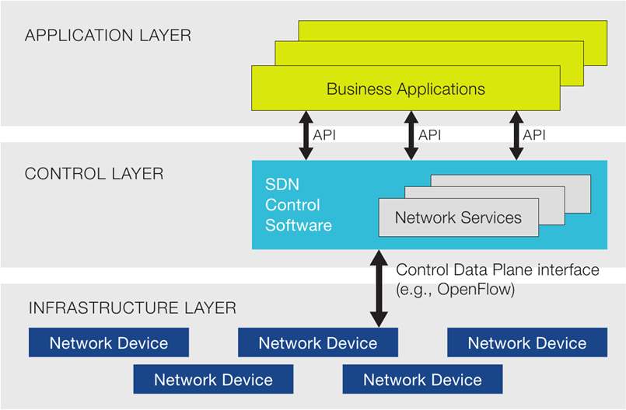





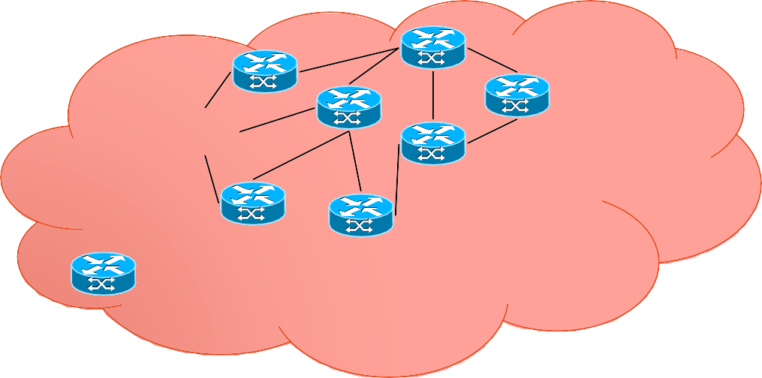
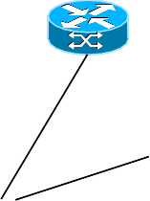
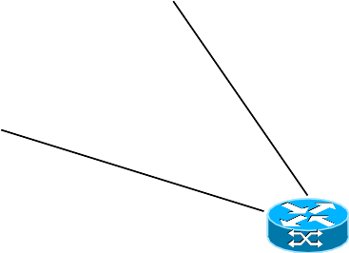
PCE & SDN
Abstraction & Algorithms over Stateful PCE
Stateful
PCE
Server
PCEP
Protocol
Stateful PCE can offer centralized control over the LSPs as a simple evolutionary approach for SDN.
PCE is a function, that is part of any SDN controller!
PCC
PCC

Slide 20
PCEP as a SBI
PCE is a core of a SDN controller
Should PCEP be upgraded to a full-fledged SBI?
What is needed to do that?
Ability to use PCEP to program each node along the path of the LSP
Ability to use PCEP for label dissemination for SR
Ability to identify which traffic flows in the LSP
Ability to use PCEP to learn topology changes
Multicast / P2MP
Coordinate between PCEs
and so on….

Slide 21


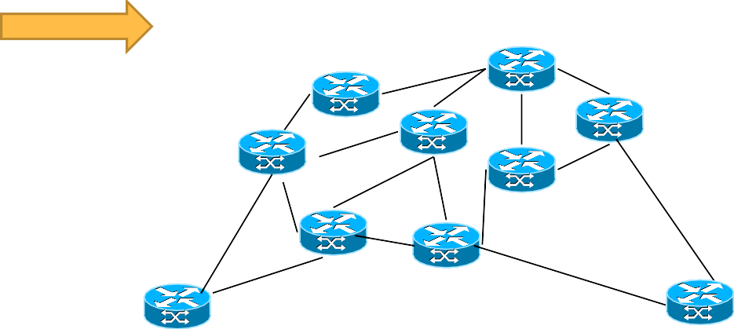


PCE as Central Controller
PCECC – PCE
Stateful PCE
with Initiation
as a central
controller
PCEP
Protocol
PCEP
Protocol
RSVP Signaling
All nodes
are PCC
PCC
PCC
Free from signaling
protocols
PCECC
communicates to all
nodes
PCECC responsible
for label allocation
Central controller!

Slide 22
PCECC
RFC8283 defines an architecture for use of PCE in a network with central control
examines the motivations/applicability for PCEP as a control protocol in SDN
A PCE-based Central Controller (PCECC)
can simplify the processing of a distributed control plane by blending it with elements of SDN and without
necessarily completely replacing it
The PCECC programs forwarding instructions (called CCI) into the network
and so is applicable to static-LSP/MPLS-SR/SRv6…

Slide 23























PCECC
PCECC can use PCEP for SR SID (Segment Identifier) distribution on the SR nodes. SR SID is just another central controller instruction (CCI)
PCE-CC
Via PCEP: Central Controller Instructions (CCI) for each forwarding action along the path like static LSPs
Via PCEP: CCI for each SR node/adj SID/label to all nodes!
Further SR stack
to Ingress
PCE-CC
6193
payload
5123
1417
payload
4106
5122
payload
payload
4106
payload

Slide 24
PCEP for Traffic Classification
When a PCE is in control (active stateful, maybe PCE-initiated)
The head-end doesn’t know why the LSP or SR-path was created
The PCE needs to tell the head-end what traffic to put on the path
Traffic Classification is a key part of TE
draft-ietf-pce-pcep-flowspec
A new FLOWSPEC object with Flow Filter TLV with one or more Flow Specification sub-TLVs
Allow re-use of BGP TLVs
  (But subtly different meaning from BGP FlowSpec!)
PCE initiates a new LSP and wants it to be used for all traffic destined to
198.51.100.0/24 and 203.0.113.0/24

Slide 25
What's Next?
Latest from IETF 108
SR extensions for PCE remains “hot”
Design team from SRv6 to handle compressed SRH in progress
PCE continue to evolve to satisfy
new networks
new deployments
new data-planes
new optimization criteria
new ways to control network
Join us at the PCE WG
pce@ietf.org

Slide 26


India Internet Engineering Society (IIESoc)
IIESoc is a pan-India group of like minded computer networking
professionals
The mission of the IIESoc is to further the adoption of Internet standards and increase participation from India in the IETF (Internet Engineering Task Force)
More at https://www.iiesoc.in/
Events
  RFCsWeLove (monthly) - https://www.iiesoc.in/rfcswelove
  Connections (Yearly) - https://www.connections.iiesoc.in/
Mailing List - https://www.ietf.org/mailman/listinfo/Ietf-community-
india

Slide 27

Thank You!
dhruv.ietf@gmail.com

